Slide 1
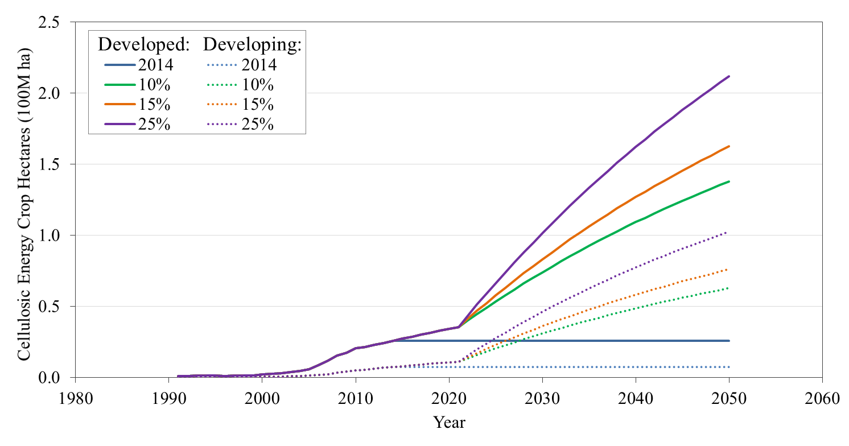
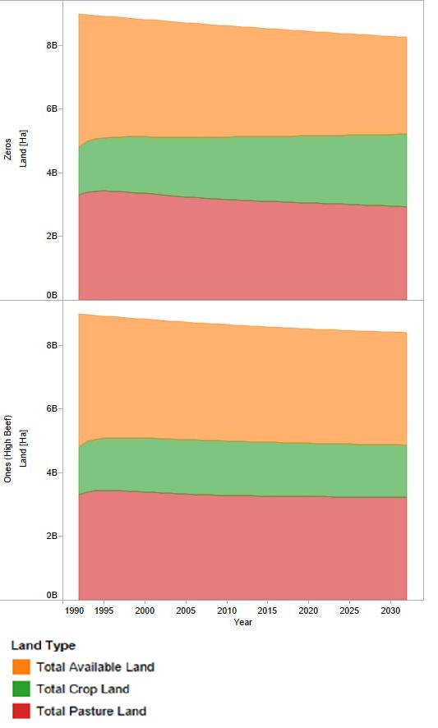
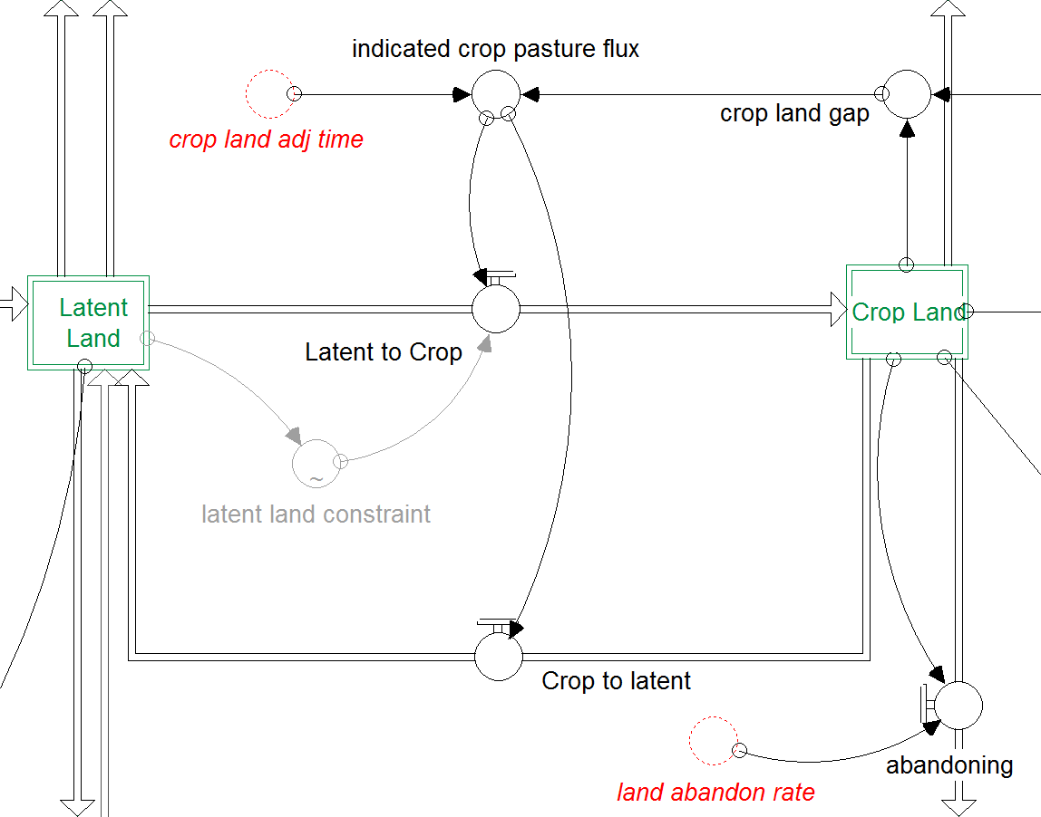
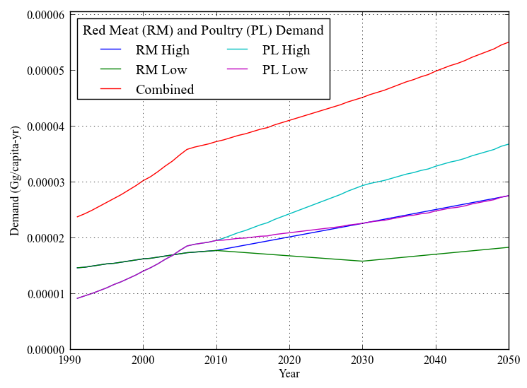
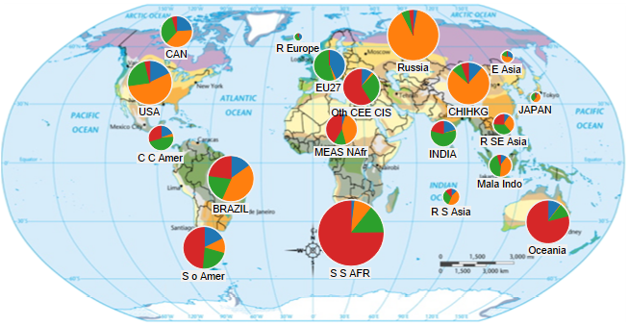

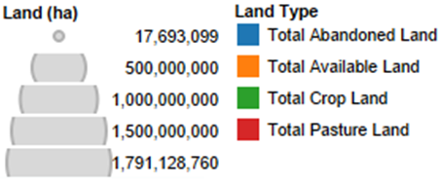
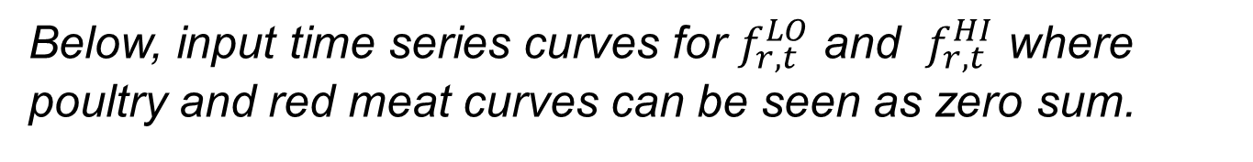
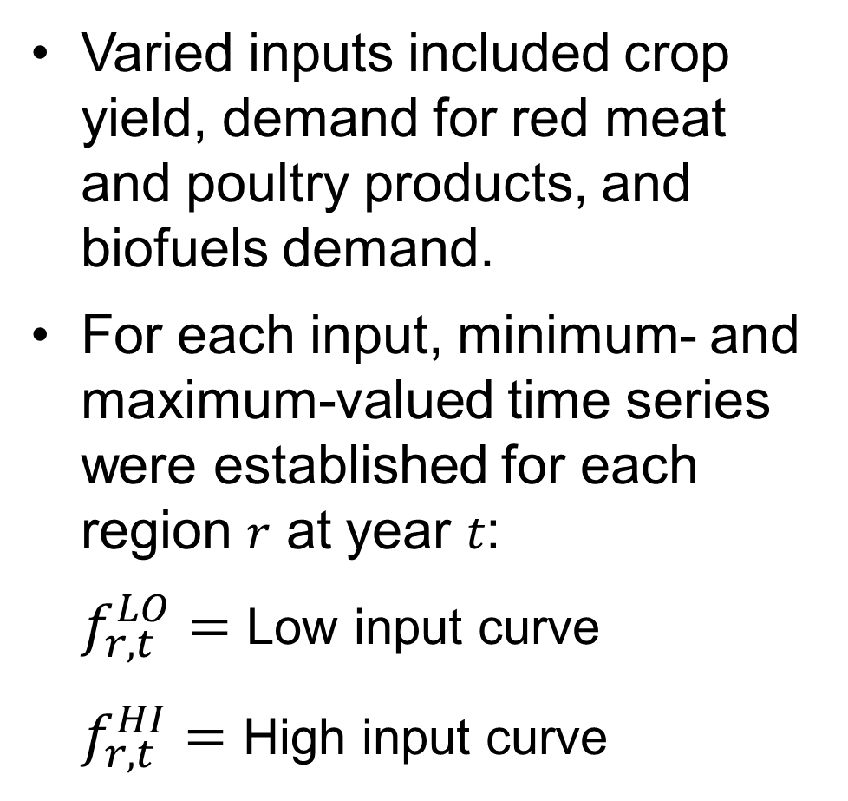
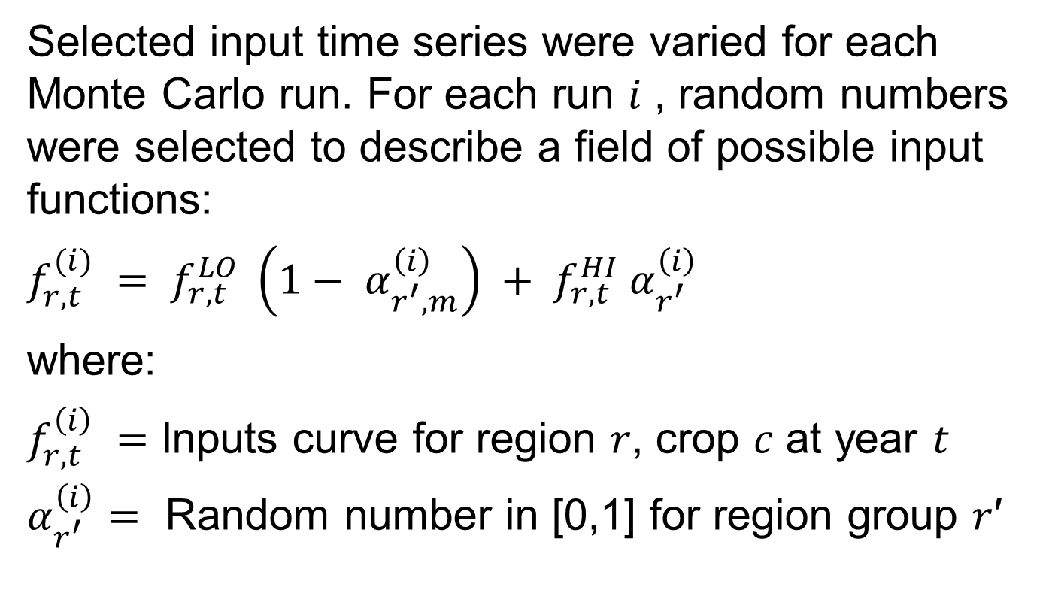
BioLUC Model Sensitivity
Eric Bryant – University of Massachusetts at Amherst
Basics
Sensitivity Analysis (SA) Objective
What is BioLUC?
BioLUC is a system dynamics model written in Isee Systems Stella™ v9.1.4 and recently upgraded to v10.x. A key remit for this summer’s work was to provide exploratory analysis of the upgraded model version. Model inputs describe various statistics for a 19-region discretization of the world, including: population, biofuels demand, and crop yield curves.
Unavoidably, BioLUC relies on analyst-provided conceptual frameworks in order to supply meaningful results. One such framework, or ‘scenario’, might be that a global increase in per capita GDP drives a decline in the rate of population growth, as well as an increase in dietary demand for animal products.
What trends does BioLUC describe?
BioLUC explores how energy policy in individual nations can drive future food supply shortfalls as well as land use allocation world-wide.
What policy issue(s) was BioLUC initiated to address?
The BioLUC modeling program was started in 2010, to address concerns that the 2007-2008 world food price crisis was a response to a fluctuation in global demand for corn ethanol - spurred by changes to energy policy in developed nations, favoring the use of renewable fuels.
Inter-scenario comparison inherently possessed limitations in describing BioLUC’s tipping points. To address this limitation, a sensitivity analysis framework was constructed, primarily in Python v2.7.
Varied inputs included crop yield, demand for red meat and poultry products, and biofuels demand.
For each input, minimum- and maximum-valued time series were established for each region 𝑟 at year 𝑡: $f_{r,t}^{LO}=$ Low input curve $f_{r,t}^{HI}=$ High input curve
Above, showing the limitations of discrete biofuels inputs, with two curves plotted for each time series - one for average demand in developed nations and one for developing nations.
Sensitivity Analysis Methodology
Selected input time series were varied for each Monte Carlo run. For each run 𝑖 , random numbers were selected to describe a field of possible input functions:
$$f_{r,t}^{(i)} = f_{r,t}^{LO} \left(1− α_{r^{′},m}^{\left(i\right)}\right) + f_{r,t}^{HI} α_{r^{′}}^{\left(i\right)}$$
where:
$f_{r,t}^{\left(i\right)} =$ Inputs curve for region 𝑟, crop 𝑐 at year 𝑡
$α_{r^{′}}^{\left(i\right)}=$ Random number in [0,1] for region group 𝑟′
Model Methods
BioLUC was implemented using a visual programming approach, with the result that the various equations and relationships in BioLUC are fixed between model runs. Differences in BioLUC output depend on variations in input functions, such as might include growth in crop yields during years 2013-2050. Yields curves may change, i.e. due to uncertainty as to rate of technological development.
Below, input time series curves for $f_{r,t}^{LO}$ and $f_{r,t}^{HI}$ where poultry and red meat curves can be seen as zero sum.
A system dynamics model is a descriptive method enabling the solution of non-linear differential equations with varied input functions, utilizing finite difference methods.
To left, a fractional view of the BioLUC system dynamics model is depicted handling input and conversion functions to the regional stocks of latent and crop land.
The development team at NREL has a goal to open source a Stella™ v10.x BioLUC model version by September 2013.
On top, global stacked time series data for sensitivity analysis boundary cases where 𝛼=0 and 𝛼=1. Lower ‘Ones’ scenario is seen to develop more pasture land, corresponding with beef demand.
Conclusion
BioLUC results for scenario UN showed only marginal changes in land use as biofuels demand was increased. Results were similar for scenario CH. This minimizing effect of increases in biofuels demand on anticipated future land use patterns was considered a crucial result of the analysis, particularly in comparison to the differentiation developed between
UN and CH at 2030.
As current, the framework of the BioLUC sensitivity analysis had been completed. Contrast between the two extreme Zeros and Ones input scenarios displayed sufficient differences to justify further work, with thus far conducted a Monte Carlo analysis of size 1,000 simulations run though year 2050.
Global Results
Scenario UN Results for 2030
Left and below, BioLUC results show anticipated 2030 land use allocation for the 19-region global discretization , with region allocation based upon similarly purposed GTAP global equilibrium economic model.¹
Results are presented for scenarios derived from WAO² and IPCC-SRES³ sources, respectively. The former anticipates increases in demand for food products, and the latter higher population growth.
‘UN’ stands for ‘Unchanged World’ and ‘CH’ for ‘Changed World’
Acknowledgements
Scenario CH Results
This work was funded by a United States Department of Energy Office of Science Summer Undergraduate Laboratory Internship, and administered by the National Renewable Energy Laboratory. Special thanks to Laura Vimmerstedt, Danny Inman and Ethan Warner, and Brian Bush for assistance with work related to HPC computing and model-based sensitivity analysis.
References
¹ R. Keeney and T.W. Hertel, American Journal of Agricultural Economics 91, 895 (2009).
² N. Alexandratos and J. Bruinsma, World Agriculture Towards 2030/2050: The 2012 Revision (2012).
³ N. Nakicenovic, J. Alcamo, and G. Davis, Special Report on Emission Scenarios (SRES) . A Special Report of Working Group III of the Intergovernmental Panel on Climate Change. Cambridge: (Cambridge University Press, Cambridge, 2000), p. 595.

